Slide 1
Week 6
PHY495: Hoop Never Misses

Slide 2
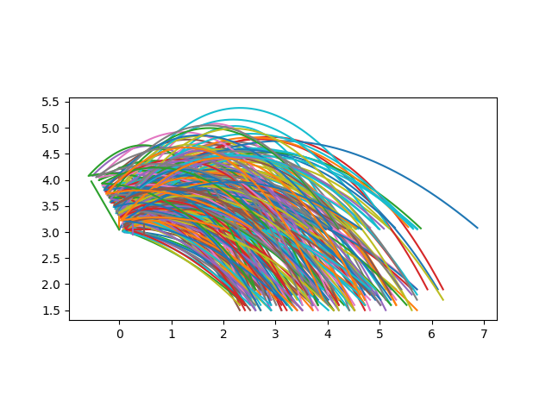
What I’ve Done – Compared three different angles
Percent in: 0.0 Angle: 1.0471975511965976
Percent in: 0.22448979591836735 Angle: 1.5707963267948966
Percent in: 0.09375 Angle: 2.0943951023931953

Slide 3
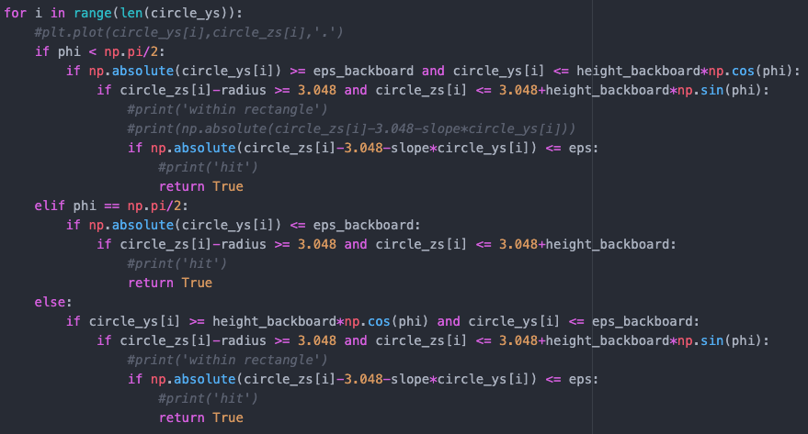
What I’ve Done
Found that some balls were hitting the bottom edge of the backboard and (if the backboard was angled backwards) would rebound up and could go in the basket. So I added the condition that at least the centre of the basketball has to hit the bottom edge (can’t be the top edge of the ball).

Slide 4
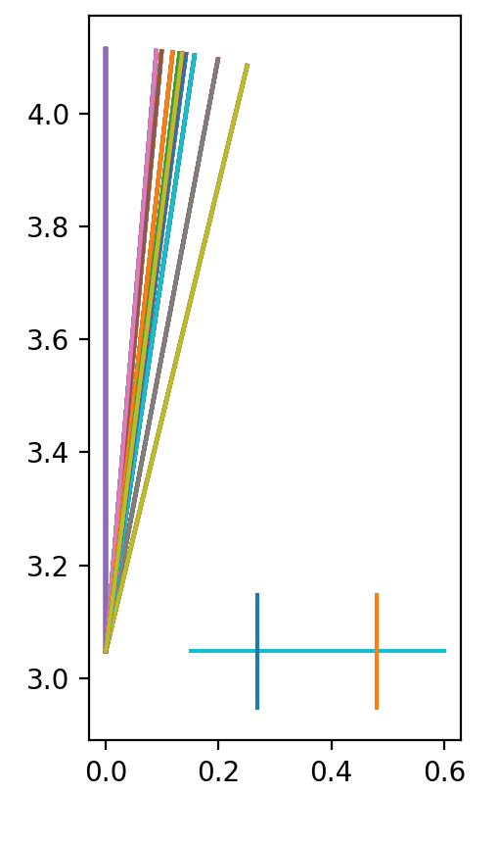
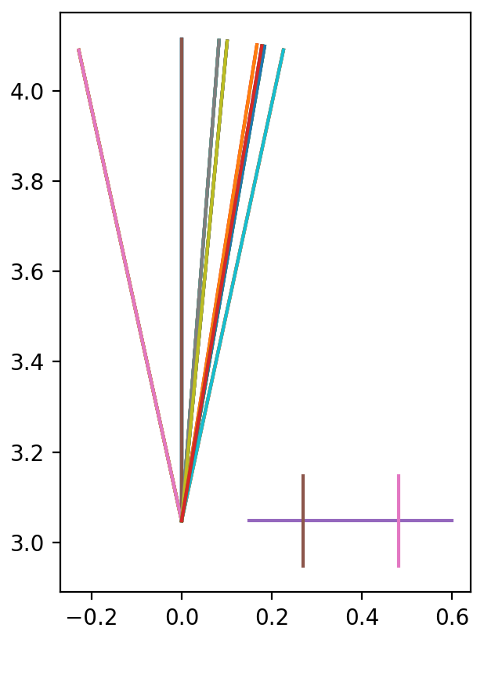
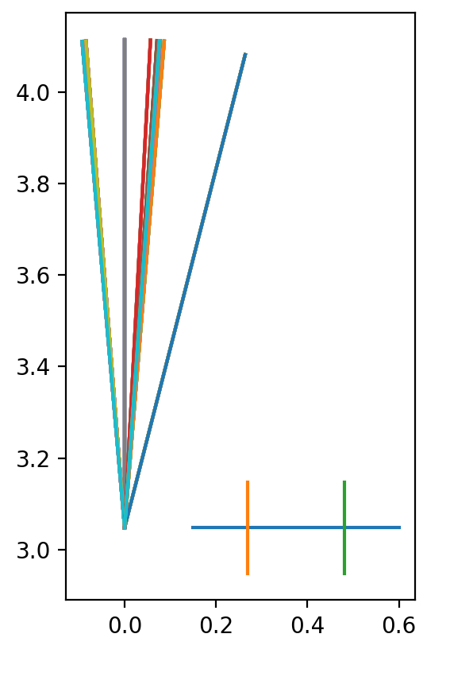
What Worked – Graphical
3 examples of trying to find the optimal angle
We can see that it converges to around the same angle (obviously we’ll need to make this more accurate)

Slide 5
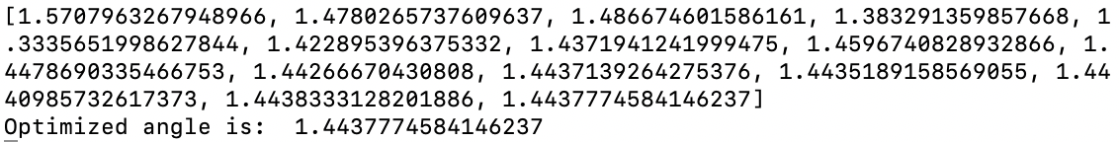
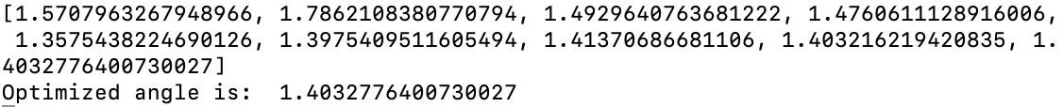
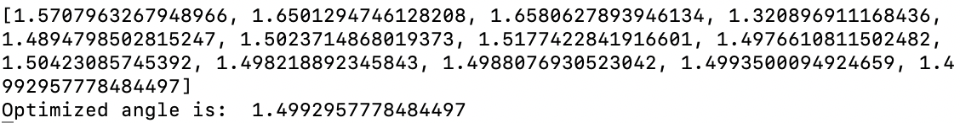
What Worked – Arrays
Same 3 examples for finding the optimal angle as the last slide

Slide 6
What Didn’t Work
Program took a while to run but tried to set up Jupyter Hub to run overnight – not sure if I ran the program correctly on Jupyter (looked different from what Michael Blackmon showed us)

Slide 7
Where am I Stuck
Parallelization
We don’t want a for loop in best_angle, so do I change the parameter for percent_in from a single angle to an array? Would this then make a nested for loop in percent_in? How do I keep track of random angles and percents in in an array?

Slide 8
What Next?
Get this code running more efficiently – parallelization
Figure out how to work the online Jupyter hub
Start figuring out the curved backboard – where do we start?

